Slide 1

Electron Minds
Notes:
Good Afternoon ,everyone. Today, I 'electron Mind team leader will be presenting our project to everyone

Slide 2
Member name
Poon Yong Hao
Míriam Elena Ondo Nguba
Subaschandran a/l Nagarajan
Notes:
I will introducte our member which is me, poon , Miriam, and subas

Slide 3
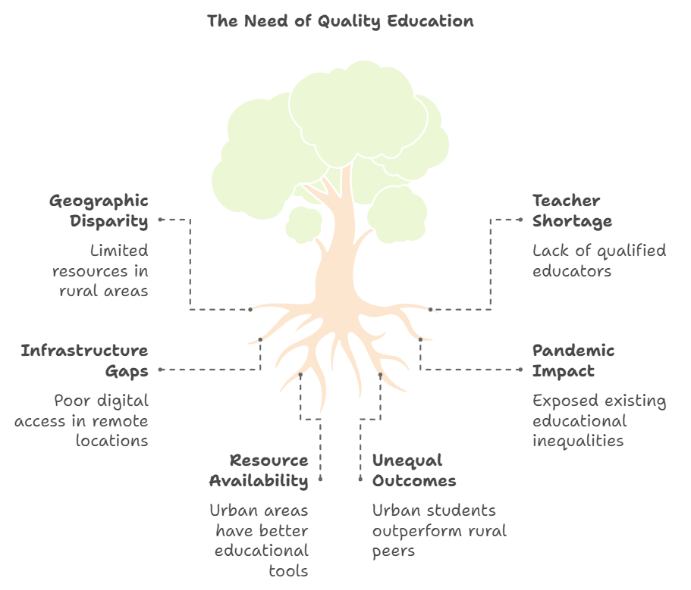
Quality Education
Notes:
The topic we choose are quality education why we need quality education because

Slide 4
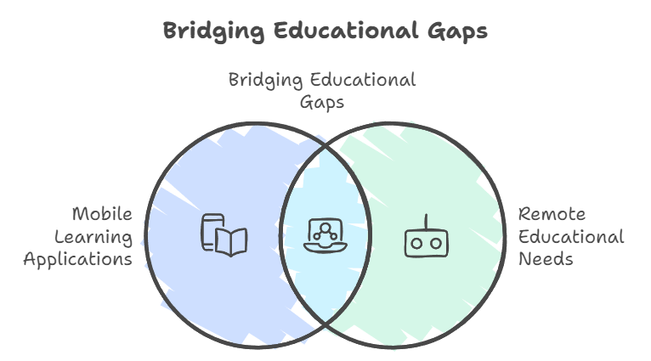
Introduction
Notes:
So, our team think that we can bridge educational gap become an application

Slide 5
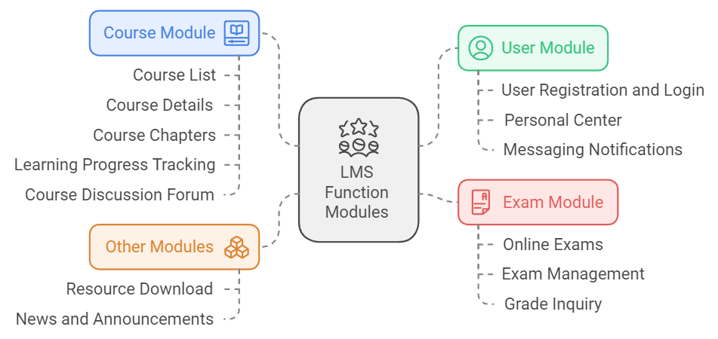
Content introduction
Notes:
Our content will about

Slide 6
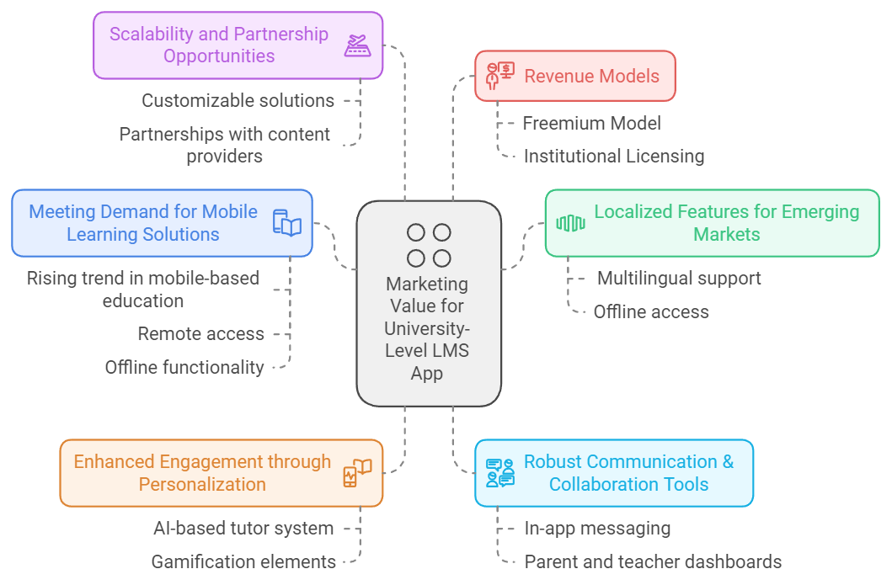
Marketing
Notes:
After that , what will be marketing among this application, for my opinion, it can

Slide 7
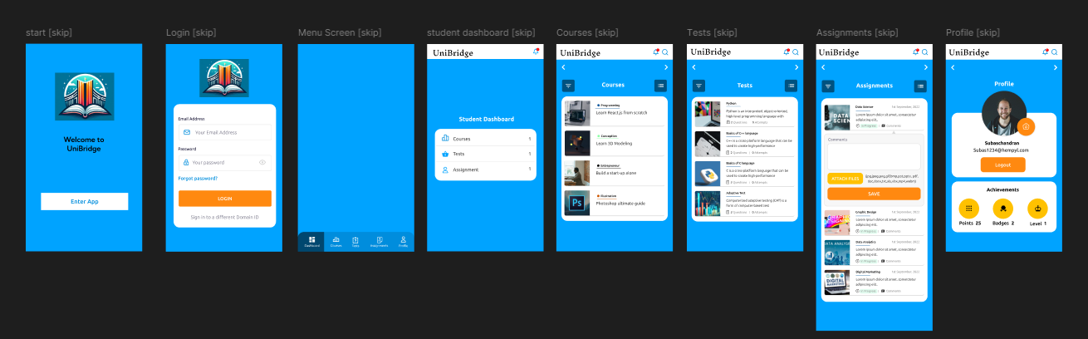
GO to Simulation Part

